Slide 1































Titanium Sponsors
Platinum Sponsors
Gold Sponsors

Slide 2
XAML: So Easy, a Web Developer Can Do It
The Kansas City Developer Conference
June 24, 2015
Michael Eaton / @mjeaton

Slide 3

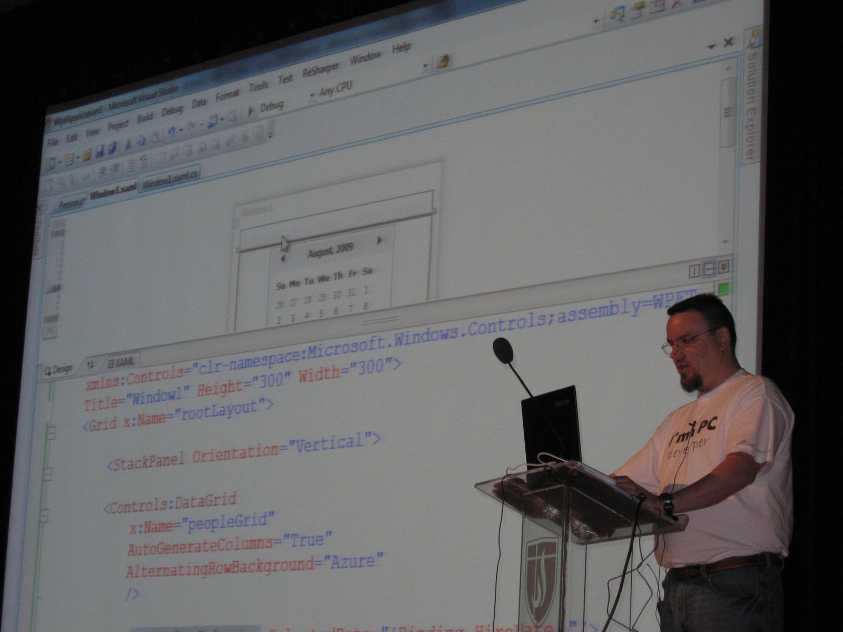





Slide 4

#1 Place to work in IT for the 3rd year in a row! http://bit.ly/quickenLoans1
We’re hiring! Interested? Let me know! @mjeaton / mikeeaton@quickenloans.com

Slide 5
about.me/mjeaton
Notes:
About.me/mjeaton

Slide 6
What is XAML?
A declarative markup language
Based on XML
Used to initialize structured values and objects
Used extensively in
WPF
Windows Phone / Windows Store / Windows 10
Windows Workflow

Slide 7
What is XAML?
Used as the UI markup language to define
UI elements
Data binding
Other features
Elements map directly to CLR object instances
Attributes map to properties and events on those objects

Slide 8
Why should I care?

Slide 9
Prerequisites for the day?
Visual Studio 2010 or greater

Slide 10
The nitty, gritty details

Slide 11
Anatomy of a XAML file
<Window | Page | UserContro
xmlns="http://schemas.microsoft.com/winfx/2006/xaml/presentation" xmlns:x="http://schemas.microsoft.com/winfx/2006/xaml"
>
<!– Stuff goes here →
</Window | Page | UserControl>

Slide 12
XAML Tags
Various ways to accomplish the same thing
<Button>This is a button</Button>
<Button Content=“This is a button”></Button>
<Button Content=“This is a button”/>

Slide 13
XAML Tags
For readability, when dealing with long pieces of XAML, place each attribute on a separate line:
<Button
Content="This is a button"
Background="Blue"
Foreground="White"
Height="35"
Width="100"
/>

Slide 14
Code vs. XAML
Anything you can do in XAML, you can do in code
var b = new Button();
b.Content = “hello, world”;
b.Click += clickedEvent;
is the same as
<Button Content=“hello, world” Click=“clickedEvent”/>

Slide 15
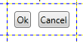
Margins
Outside spacing Left, Top, Right, Bottom
If all margins are the same, you may use the alternate syntax of Margin=“10”
Note: Units are Device Independent
<StackPanel
Orientation="Horizontal"
Grid.Row="3"
Grid.Column="1"
Margin="10,10,10,10"
>
<Button Content="Ok" Margin="0,0,10,0" />
<Button Content="Cancel" />
</StackPanel>

Slide 16
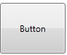
Padding
Inside spacing Left, Top, Right, Bottom
If the padding values are the same, you may use the alternate syntax of Padding=“10”
Note: Units are Device Independent
<Button Content="Button" Padding="25"

Slide 17
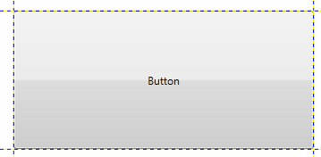
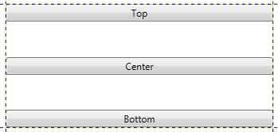
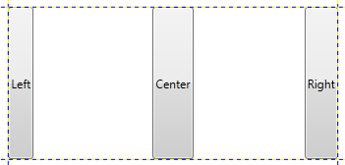
Alignment
Defaults = “Stretch”
<Button Content="Button" />
<Button Content="Top" VerticalAlignment="Top" /> <Button Content=“Center" VerticalAlignment=“Center" /> <Button Content=“Bottom" VerticalAlignment=“Bottom" />
<Button Content="Left" HorizontalAlignment="Left" />
<Button Content="Center" HorizontalAlignment="Center" />
<Button Content="Right" HorizontalAlignment="Right" />

Slide 18
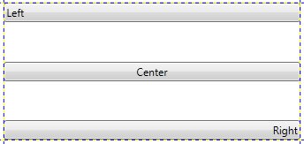
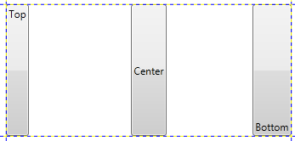
ContentAlignment
HorizontalContentAlignment and VerticalContentAlignment
Applies to Content controls such as buttons
<Button Content="Left" HorizontalContentAlignment="Left" />
<Button Content="Center" HorizontalContentAlignment="Center" />
<Button Content="Right" HorizontalContentAlignment="Right" />
<Button Content="Top" VerticalContentAlignment="Top" />
<Button Content="Center" VerticalContentAlignment="Center" />
<Button Content="Bottom" VerticalContentAlignment="Bottom" />

Slide 19
Layouts and Controls Demos
Using Kaxaml

Slide 20
Data Binding
Allows us to connect data to an element on the screen
Extremely powerful
Data can come from many different sources
WPF doesn’t care what the source is
Used everywhere
Enables MVVM

Slide 21
Data Binding
DataContext
provides a convenient way to establish a data scope
multiple targets can share the same source
Notes:
Demo

Slide 22
Data binding
Source: Where the data is coming from
Target: Where the data will be displayed

Slide 23
Data Binding
A typical data binding assignment in XAML
<TextBox Text=“{Binding FirstName}”/>
The data source is typically set using the .DataContext property of a parent object.
Typically done via the code-behind unless you’re using MVVM (this will be in a later lesson)
Notes:
This says the Text property of the textbox will display data in the FirstName property of our data source.

Slide 24
Binding Mode
OneWay: Updates target when source is updated.
TwoWay: Changes to source or target update the other
OneWayToSource: Updates source when target is updated
OneTime: Updates the binding target when the application starts or when the data context changes.

Slide 25
Raising Notifications
INotifyPropertyChanged
public event PropertyChangedEventHandler PropertyChanged;
public void RaisePropertyChanged(string propertyName) { if(PropertyChanged != null) { PropertyChanged(this, new PropertyChangedEventArgs(propertyName)); } }

Slide 26
Collections
ObservableCollection<T>
notification when items are added or removed.
Assign to .ItemsSource of ListBox, ComboBox, DataGrid, etc.
Once you’ve assigned .ItemsSource, you cannot manually add items

Slide 27
Converters
Used when the source data isn’t in the format you want for displaying on the screen
Converts during the binding process
Implements IValueConverter interface
Convert and ConvertBack methods

Slide 28
Common Converters
BooleanToVisibilityConverter
public class BooleanToVisibilityConverter : IValueConverter
{
public object Convert(object value, Type targetType, object parameter, CultureInfo culture)
{
if (targetType != typeof(Visibility))
throw new InvalidOperationException("The target must be visibility");
if((bool)value)
return Visibility.Visible;
return Visibility.Hidden;
}
public object ConvertBack(object value, Type targetType, object parameter, CultureInfo culture)
{
throw new NotSupportedException();
}
}
}

Slide 29
Usage of BooleanToVisibilityConverter
<Button
Content=“Value that may be hidden”
Visibility="{Binding IsManual, Converter={StaticResource VisibilityOfBool}}"
/>

Slide 30
StringFormat
Can be used to format a string directly in a binding statement
<TextBox Text=“{Binding HireDate, StringFormat={}{0:MM/dd/yyyy}}”/>
<TextBox Text=“{Binding Amount, StringFormat=Amount: {0:C}}”/>

Slide 31
Binding Demos
Using Kaxaml and Visual Studio

Slide 32
Styles and Templates
Controls the look and feel of an application
Can completely change how a control looks
Notes:
A button doesn’t have to be a gray rectangle
A listbox doesn’t have to contain simple strings
Allows you to easily apply standard colors, fonts, etc.

Slide 33
Styles
Can be applied to any object which derives from FrameworkElement or FrameworkContentElement, both of which expose a public property named Style.
Local / global
Defines the appearance of a control

Slide 34
Styles
Styles can live in several places
App.xaml
<Application.Resources>
Available globally
<Window|Page|UserControl.Resources/>
Available only within that particular window, page or usercontrol
<Control.Resources>
<Button.Resources>, <Grid.Resources>, etc.
Only available within the context of that particular control

Slide 35
Style and Template Demos
Using Kaxaml and Visual Studio

Slide 36
about.me/mjeaton
Notes:
About.me/mjeaton

